Slide 1
MATLAB For Mathematical Scince
By Assist Lac. Asmaa kh.

Slide 2
University of Diyala
College of Science
Department of Mathematics
Course Book
of
Mathematical Computation
Second Year Mathematics
2018-2019
Assit.Lecturer: Asmaa Kh. Abdul-rahman
Emial: asmaaalshaiby@Gmail.com
Mob:

Slide 3
Format
4 hrs/week of lecture, 2 hrs/week theoretical & 2 hrs/week practical
Course Objective:
The computer program MATLAB is a powerful tool which can help you solve a wide range of mathematical problems: it can differentiate, integrate, and otherwise manipulate mathematical formulas, perform arithmetic calculations, plot curves and surfaces in two and three dimensions, solve differential equations, and carry out a variety of other useful mathematical operations, At Rutgers, MATLAB is available on the student computer Eden. MATLAB is also available on the Windows PCs and Macintoshes in the public labs. Although the commands you use to do mathematics with MATLAB will be the same on all these machines, there are differences among computers, such as in the way that, les are opened, saved and printed.

Slide 4
With MATLAB, you can create powerful interactive documents. The MATLAB environment lets you start solving problems right away by entering expressions in 2-D Math and solving these expressions using point-and-click inter- faces. You can combine text and math in the same line, add tables to organize the content of your work, or insert images, sketch regions, and spreadsheets. You can visualize and animate problems in two and three dimensions, format text for academic papers or books, and insert hyperlinks to other MATLAB files, Web sites, or email addresses. You can embed and program graphical user interface components, as well as devise custom solutions using the MATLAB programming language.
Grading
Your course grade will be determined as follows:
Midterm exams: 34%
Lab + Quiz: 16%
Final Exam: theoretical: 34%
Practical: 16%

Slide 5
Course material
A Guide to MATLAB for Beginners and Experienced Users Second Edition, Brian R. Hunt, Cambridge, 2006.
An Introduction to MATLAB, Winfried Auzinger, Vienna, 2002.
Applied Numerical Methods Using Matlab, Won Young Yang, New Jersey, 2005.
Learning MATLAB 7, The MathWorks, 2005.
Numerical Analysis Using MATLAB and Spreadsheets, Second Edition, Steven T. Karris, Orchard Publications, 2004.

Slide 6
Computer programming Introduction To Matlab By Assist Lac. Asmaa kh.
Introduction to MATLAB
MATLAB ( Matrix Laboratory ) is an interactive software system for numerical computations and graphics . As the name suggests . MATLAB is especially designed for matrix computations, solving systems of linear equations , computing eigenvalues and eigenvectors factorization of matrices, and so much .
In addition, it has a variety of graphical capabilities, and can be extended through programs written in its own programming language . many such programs come with the system; these extend MATLAB’ s capabilities to a wide range of applications, like the solution of nonlinear systems of equations , the integration of ordinary and partial differential equations. and many others.

Slide 7
Computer programming Introduction To Matlab By Assist Lac. Asmaa kh.
Starting MATLAB
However you start MATLAB, you will briefly see a window that displays the MATLAB logo as well as some product information, and then a MATLAB Desktop window will launch. That window will contain a title bar, a menu bar, a tool bar and four embedded windows. The largest and most important window is the Command Window on the middle, the Command History Window and the Workspace in right, the Current Directory Browser in left. For now we concentrate on the Command Window in order to get you started issuing MATLAB commands as quickly as possible. At the top of the Command Window, you may see some general information about MATLAB, perhaps some special instructions for getting started or accessing help, but most important of all, you will see a command prompt (>> ). If the Command Window is “active,” its title bar will be dark, and the prompt will be followed by a cursor (a blinking vertical line). That is the place where you will enter your MATLAB commands. If the Command Window is not active, just click in it anywhere. Figure 1.1 contains an example of a newly launched MATLAB

Slide 8
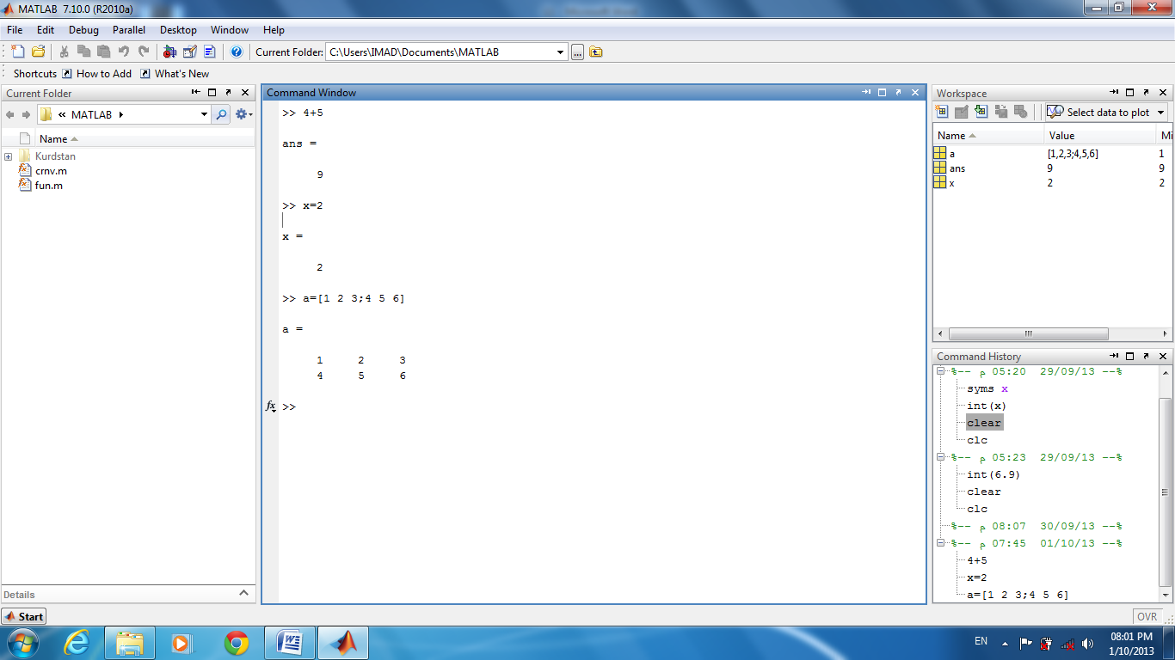

Slide 9
Computer programming Introduction To Matlab By Assist Lac. Asmaa kh.
Desktop:
Command Window: - Use the Command Window to enter variables and to run MATLAB functions and scripts. MATLAB displays the results. Press the up arrow key ↑ to recall a statement you previously typed. Edit the statement as needed, and then press Enter to run it.
Command History:-Statements you enter in the Command Window are logged with a timestamp in the Command History. From the Command History, you can view and search for previously run statements, as well as copy and execute selected statements.
Workspace: - The workspace consists of the set of variables built up during a session of using the MATLAB software and stored in memory. You add variables to the workspace by using functions, running M-files, and loading saved workspaces.
Current Directory Browser:-the files and subdirectories it contains are listed in the Current Directory Browser.

Slide 10
Computer programming Introduction To Matlab By Assist Lac. Asmaa kh.
Typing in Command Window
Abort :
In order to abort a command in MATLAB, hold down the control key and press c to generate a local abort with MATLAB.
The Semicolon (;) :
If a semicolon (;) is typed at the end of a command the output of the command is not displayed.
Typing % :
When percent symbol (%) is typed in the beginning of a line, the line is designated as a comment. When the enter key is pressed the line is not executed.
The clc Command :
Typing clc command and pressing enter cleans the command window. Once the clc command is executed a clear window is displayed.
Help :
MATLAB has a host of built-in functions. For a complete list, refer to MATLAB users
guide or refer to the on line Help. To obtain help on a particular topic in the list, e.g., inverse, type help inv.

Slide 11
Computer programming Introduction To Matlab By Assist Lac. Asmaa kh.
Arithmetic Operations
The symbols for arithmetic operations with scalars are summarized below in Table

Slide 12
Computer programming Introduction To Matlab By Assist Lac. Asmaa kh.
Elementary Math Built in Functions
MATLAB contains a number of functions for performing computations which require the use of logarithms, elementary math functions, and trigonometric math functions. List of these commonly used elementary MATLAB mathematical built-in functions are given in
Tables.

Slide 14
Computer programming Introduction To Matlab By Assist Lac. Asmaa kh.
PROGRAMMING IN MATLAB
M-files: Scripts and functions
To take advantage of MATLAB’s full capabilities, we need to know how to construct long (and sometimes complex) sequences of statements. This can be done by writing the commands in a file and calling it from within MATLAB. Such files are called “m-files” because they must have the filename extension “.m”. This extension is required in order for these files to be interpreted by MATLAB.
There are two types of m-files: script files and function files.

Slide 15
Computer programming Introduction To Matlab By Assist Lac. Asmaa kh.
Script files contain a sequence of usual MATLAB commands, that are executed (in order) once the script is called within MATLAB. For example, if such a file has the name compute .m , then typing the command compute at the MATLAB prompt will cause the statements in that file to be executed. Script files can be very useful when entering data into a matrix.

Slide 16
Computer programming Introduction To Matlab By Assist Lac. Asmaa kh.
$\text{Example}\text{:− }\text{Create} \text{the} \text{script} \text{file} \text{then} \text{write} \text{a} \text{program} \text{to} \text{find} \text{the} \text{roots} \text{of} \text{equation}$"2x2 -3x+1=0"$\text{.}$
$$\text{Sol}\text{:}$$
$$\text{\% }\text{This} \text{Program} \text{written} \text{to} \text{Find} \text{the} \text{Roots} \text{of} \text{Equation}\text{ 2}\text{x}\text{^2−3}\text{x}\text{+1=0\%}$$
a=2; b=-3; c=1;
x1=(-b+sqrt(b^2-4*a*c))/2
x2=(-b-sqrt(b^2-4*a*c))/2

Slide 17
Computer programming Introduction To Matlab By Assist Lac. Asmaa kh.
Input and output command
Input
The input function can be used for requesting user input. For example,
r=input('value for r: ');
displays value for r:
to the screen and waits for the user to enter an expression which is then assigned to r.
Disp(X)
disp(X) displays an array, without printing the array name. If X contains a text string, the string is displayed. Another way to display an array on the screen is to type its name, but this prints a leading "X=," which is not always desirable. Note that disp does not display empty arrays.
>> disp('string expression');
string expression
>> A=[3,2;2,3];
disp(A);
3 2
2 3

Slide 18
Computer programming Introduction To Matlab By Assist Lac. Asmaa kh.
fprintf
The fprintf command displays output (text and data) on the screen or saves it to a file. The output can be formatted using this command.
fprintf (format,A,...) writes to standard output—the screen. The format string specifies notation, alignment, significant digits, field width, and other aspects of output format. It can contain ordinary alphanumeric characters; along with escape characters, conversion specifiers, and other characters, organized as shown below:

Slide 19
Computer programming Introduction To Matlab By Assist Lac. Asmaa kh.
For more information see “Tables” and “References”

Slide 20
Computer programming Introduction To Matlab By Assist Lac. Asmaa kh.
Example:-
>> x = 2; y = sqrt(x);
>> fprintf('The squrt root of %g is %9.4f\n',x,y)
The squrt root of 2 is 1.4142
Example:-
>> x = 1:4; y = sqrt(x);
>> fprintf('The squrt root of %d is %4.2f\n',[x;y])
The squrt root of 1 is 1.00
The squrt root of 2 is 1.41
The squrt root of 3 is 1.73
The squrt root of 4 is 2.00

